Slide 1
Database Administration Bundle
DAB
Notes:
Color of icons: #A39AB3 (HEX)

Slide 2
Contents
Feedback
Current problem
Requirements
Challenges
Solution
Architecture
Boundaries of DAB
Workflow
Future of DAB

Slide 3
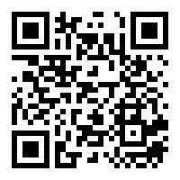
Feedback
https://forms.gle/p4WE5JaHqFVH74bh6
Notes:
tesat

Slide 4



Current problem
Additional problems:
Setting database back to default
Restoring database

Slide 5
Requirements
Python & PostgreSQL
High level requirements:
Students should be able to create databases
Teachers should be able to create courses
Students should be able to use the schema set by the teacher
Ease of use

Slide 6



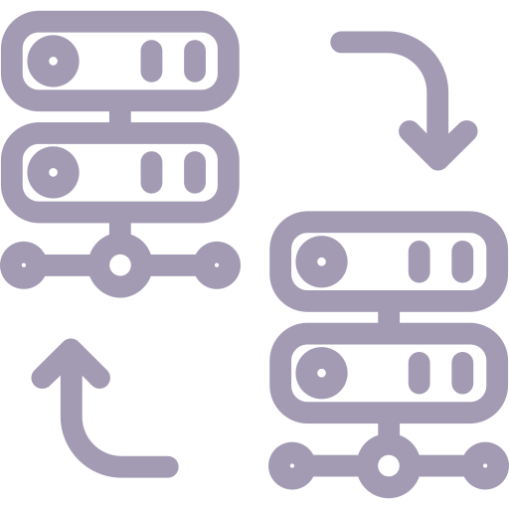

Challenges
Administrator
Teacher
TA
Student
Deep database integration
Portability
RDMS
Easy to use

Slide 7
Solution

Slide 8
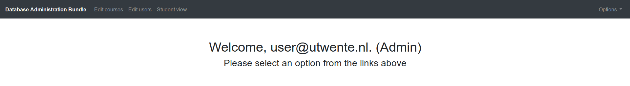
Solution - menu

Slide 9
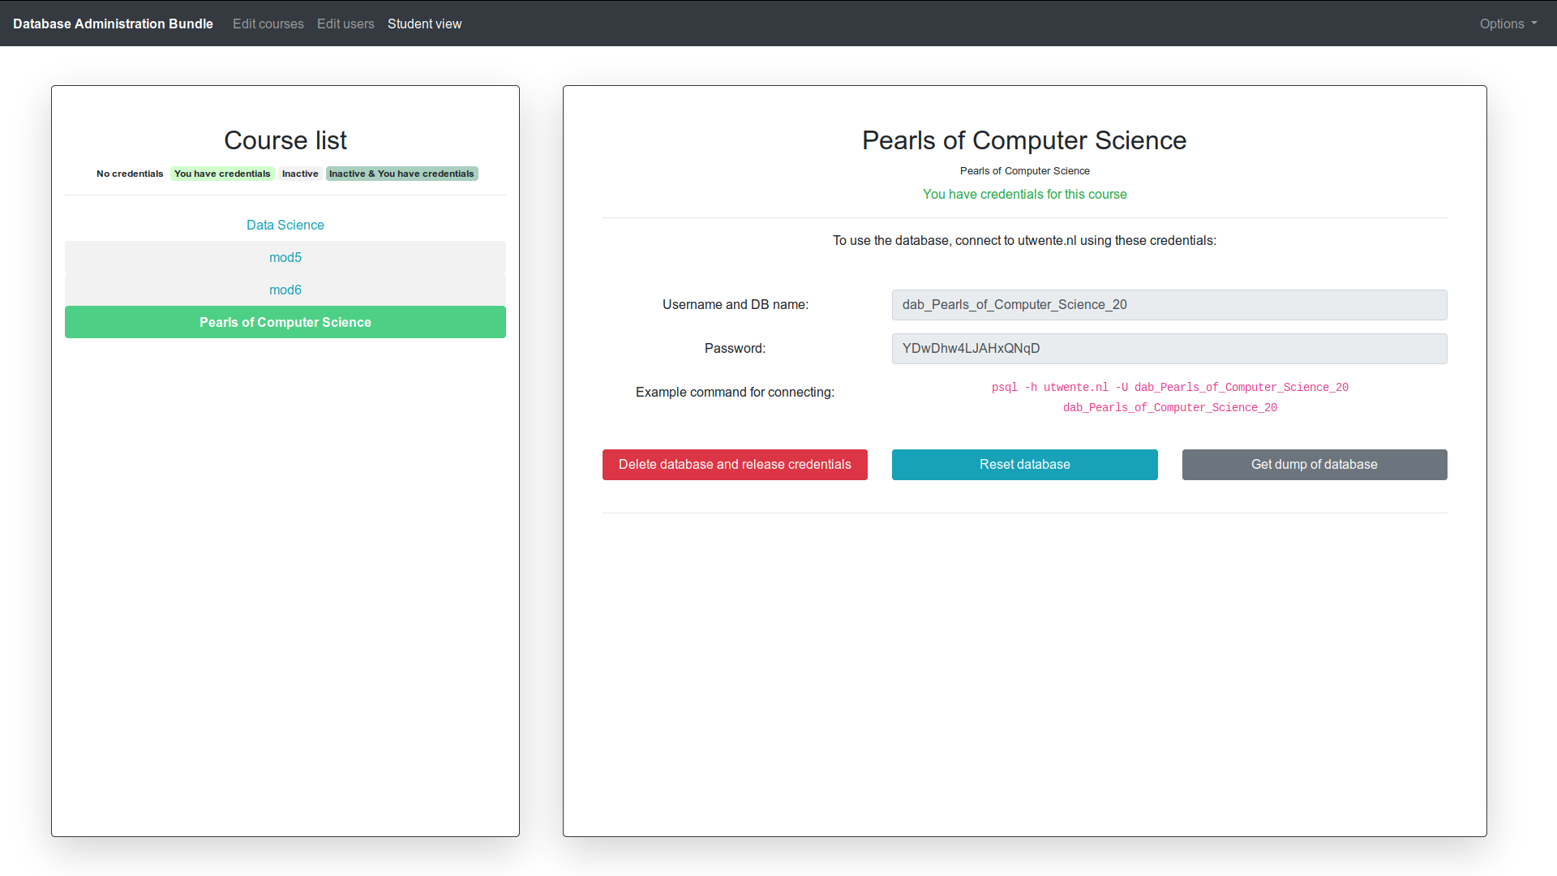
Solution - student view

Slide 10
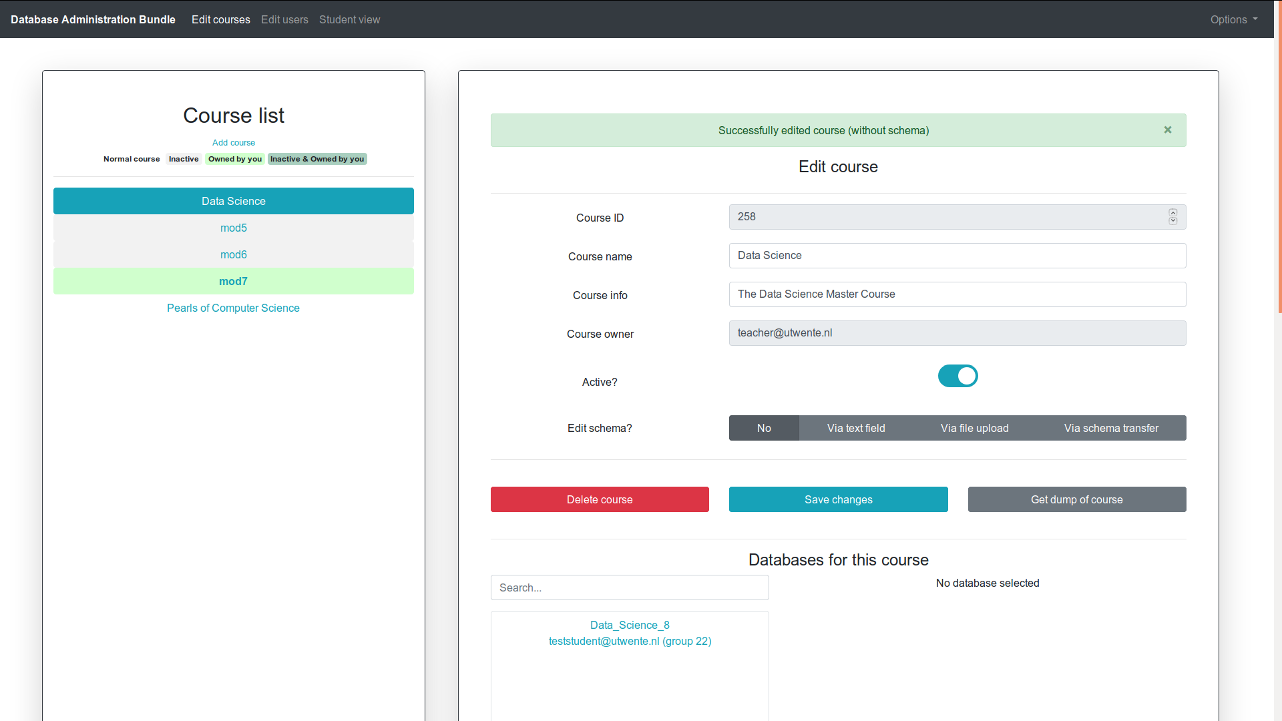
Solution - edit courses

Slide 11
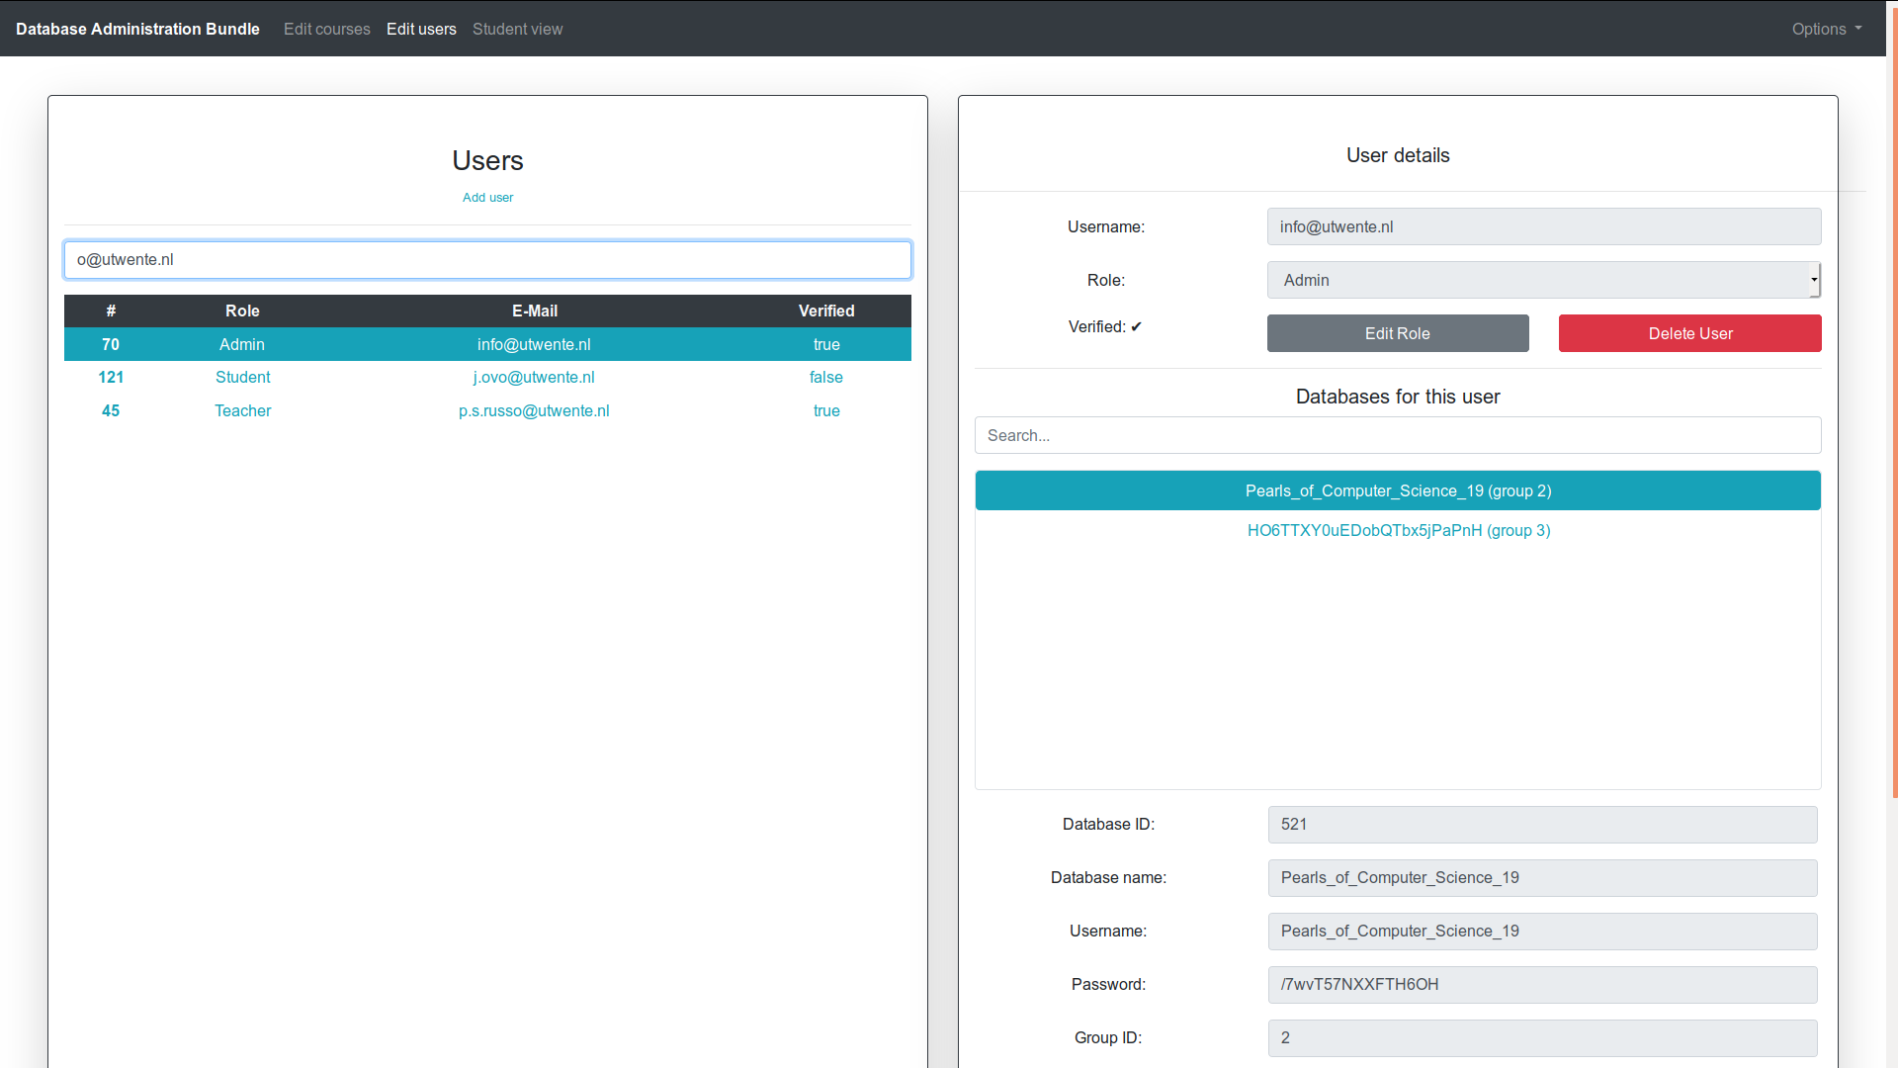
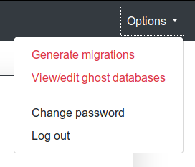
Solution - edit users

Slide 12




Architecture
DAB
Notes:
Ful stack framework

Slide 13
Boundaries of DAB
Not directly editing tables
Database schema creation inside of web UI
Automatic backups -> design decision together with client

Slide 14



Workflow
Frontend
Backend
REST
Typescript
Weekly meeting

Slide 15



Future of DAB
Integration:
OAuth
Horus
After care
Stress test
Additions:
RDMS options
Docker

Slide 16
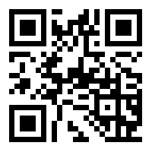
Live version
https://bronto.ewi.utwente.nl/dab/
Username: teacher@utwente.nl
Password: Aoeuaoeu1

Slide 17


